Slide 1
Twitter Sentiment Analysis
NLP Project
FINAL REVIEW
18K41A0562
18K41A0564
18K41A0574
18K41A0599
By Team : 19

Slide 2
ABSTRACT
Social media have received more attention nowadays. Public and private opinion about a wide variety of subjects are expressed and spread continually via numerous social media. Twitter is one of the social media that is gaining popularity. Twitter offers organizations a fast and effective way to analyze customers’ perspectives toward the critical to success in the
market place. Developing a program for sentiment analysis is an approach to be used to computationally measure customers’ perceptions.

Slide 3
INTRODUCTION
Twitter is a popular microblogging service where users create status messages (called “tweets”). These tweets sometimes express opinions about different topics. We propose a method to automatically extract sentiment (positive or negative) from a tweet. This is very useful because it allows feedback to be aggregated without manual intervention.
Consumers can use sentiment analysis to research products or services before making a purchase. Marketers can use this to research public opinion of their company and products, or to analyze customer satisfaction. Organizations can also use this to gather critical feedback about problems in newly released products.

Slide 4
OVERVIEW
The overall benefits of Twitter sentiment analysis include:
Scalability: Analyze hundreds or thousands of tweets mentioning your brand and automate manual tasks. Easily scale sentiment analysis tools as your data grows and gain valuable insights on the go.
Real-Time Analysis: Twitter sentiment analysis is essential for monitoring sudden shifts in customer moods, detecting if complaints are on the rise, and for taking action before problems escalate. With sentiment analysis, monitor brand mentions on Twitter in real-time and gain actionable insights.
Consistent Criteria: Avoid inconsistencies that stem from human error. Customer reps won’t always agree on which tag to use for each piece of data, so you may end up with inaccurate results. Instead, machine learning models perform sentiment analysis using one set of rules, so you can ensure all your Twitter data is tagged consistently.

Slide 5
SURVEY
In [1], they proposed a Hadoop based framework that captures real time tweets and processes it with a set of algorithms which identifies sarcastic sentiment effectively. They observed that the elapse time for analyzing and processing under Hadoop based framework significantly outperforms the conventional methods and is more suited for real time streaming tweets.
In [2], author proposed two approaches to detect sarcasm in the text of Twitter data. The first is a parsing-based lexicon generation algorithm (PBLGA) and the second was to detect sarcasm based on the occurrence of the interjection word. The combination of two approaches is also shown and compared with the existing state-of-the-art approach to detect sarcasm. First approach attains a 0.89, 0.81 and 0.84 precision, recall and f - score respectively. Second approach attains 0.85, 0.96 and 0.90 precision, recall and f - score respectively in tweets with sarcastic hashtag.

Slide 6
In [3], authors introduced a novel approach for automatically classifying the sentiment of Twitter messages. These messages are classified as either positive or negative with respect to a query term. They present the results of machine learning algorithms for classifying the sentiment of Twitter messages using distant supervision. They also describe the preprocessing steps needed to achieve high accuracy.
Here every research, used the manually detected sentiments of tweets to train the model and then using api or manually collected tweets for performing.

Slide 7
IMPLEMENTATION
In our proposed system, we used tweepy and textblob libraries to find the sentiment in tweets. There is no large public dataset of tweets for analysis, so we collect our own data. Twitter has Application Programming Interface (API) to access tweets for a particular constraint programmatically. In the API, we can set which language tweets to be extracted, here we keep it default i.e., English. Our system will propose only English tweets only.
We extract different tweets based on a particular constraint. After extracting tweets we will filter it out by eliminating hashtags, mentions and other keywords, which are not part of the tweets. After filtering the tweets, we just use textblob to analysis the polarity in the tweets. According to the polarity of that tweets, we will categorize them in to either positive or negative, if not both to neutral.
We can extract certain amount of tweets, and process them all at a time. And get the sentiment of that tweets. Also, we performed the analysis of the tweets without cleaning of the tweets because it uses keyword or hashtags to retrieve tweets.

Slide 8
Libraries
Tweepy
Textblob
Pandas, Matplotlib

Slide 9
Twitter Sentiment Analysis Use Cases
Social Media Monitoring
Customer Service
Market Research
Brand Monitoring
Political Campaigns

Slide 10
DATASET
Data availability Another difference is the magnitude of data available. With the Twitter API, it is very easy to collect millions of tweets for training.
Language model Twitter users post messages from many different media, including their cell phones. The frequency of misspellings and slang in tweets is much higher than in other domains.
Domain Twitter users post short messages about a variety of topics. This differs from a large percentage of past research, which focused on specific domains such as movie reviews.

Slide 11
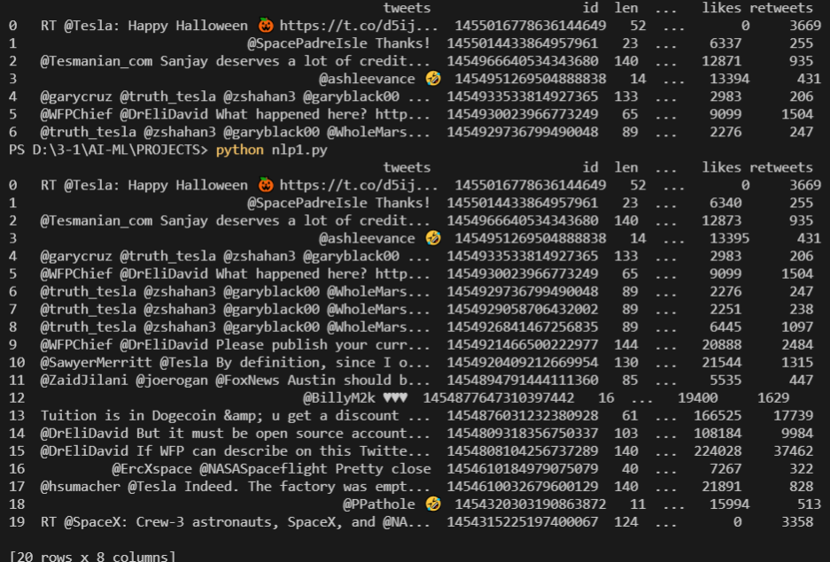
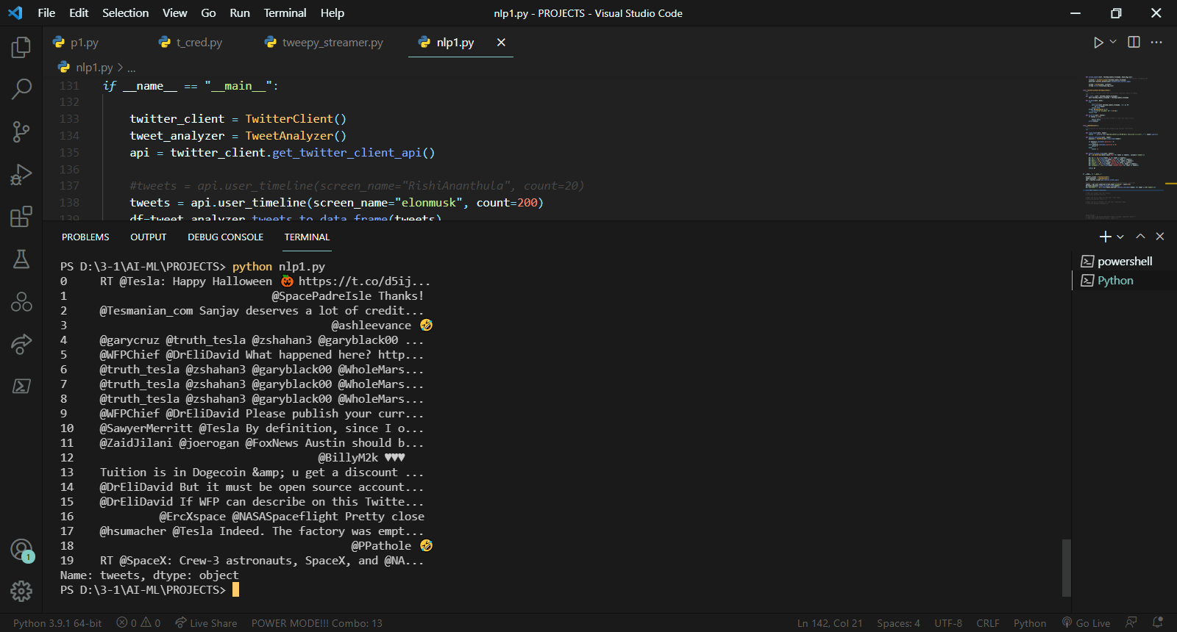

Slide 12
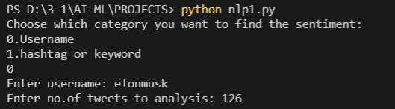
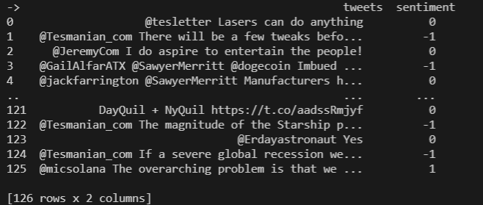
RESULTS

Slide 13
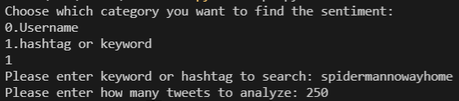
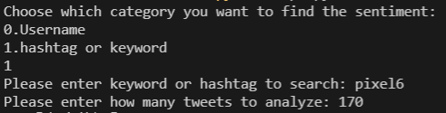
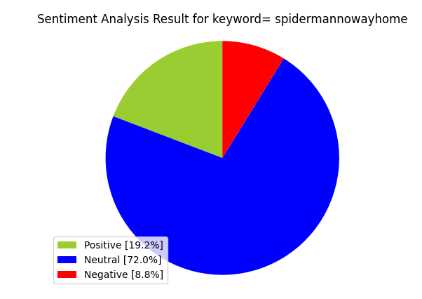
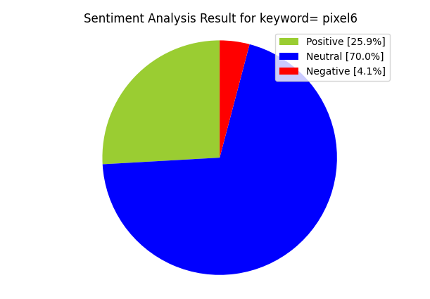

Slide 14
CONCLUSIONS
Sentiment analysis helps you monitor your customers emotions on Twitter and understand how they feel. It adds an extra layer to the traditional metrics used to analyze the performance of brands on social media, and provides businesses with powerful opportunities.

Slide 15
References:
https://monkeylearn.com/blog/sentiment-analysis-of-twitter/
https://www.sciencedirect.com/science/article/pii/S235286481630027X
https://ieeexplore.ieee.org/abstract/document/7403723
Twitter_Sentiment_Classification_using_D.pdf

Slide 16
…THANK YOU…

